Slide 1
IMDB MOVIE ANALYSYS
Project Description:
Approach:
Provided with dataset having various columns of different IMDB Movies.
You are required to provide a detailed report for the below data record mentioning the answers of the questions that follows.
Requirement:
We are going to Clean the data, and then create charts and graphs to meet the business requirement in Excel.
We are going to find some Insights such as “DATA CLEANING”, “MOVIE WITH HIGHEST PROFIT”, “IMDB TOP 250”, “BEST DIRECTORS”, “POPULAR GENRE”, “CRITIC FAVOURITE & AUDIENCE FAVOURITE” to find some major insights that can help the company grow.
Tech-Stack Used:
Excel(MS Office Home & Student 2019 .

Slide 2
DATA CLEANING
Checking for Missing Data, Extra Unwanted Columns
There are more than 10 columns which are not needed for our analysis and it has been shown in the next slide.
There are blanks in many columns and it has been mentioned in the next slide
The ‘movie _title’ column needs some cleaning as it contains extra alphabets.
There are few rows with wrong director names and these needs to be removed.
NOTE: We will do Missing Value Treatment for those rows which have no values in them. Here we can see that these rows are
very less in numbers so we can just delete those rows in excel to not include those data in the final sheet and Visualization.

Slide 3
DATA CLEANING
Deleted Columns(Not required for our analysis) | Deleted Blanks from (column) | Deleted Unwanted Data from
colour | director_name | Director_name
movie_facebook_likes | duration
aspect_ratio | num_critics_for_review
actor_2_facebook_likes | actor_1_name
cast_total_facebook_likes | budget
actor_1_facebook_likes | gross
actor_3_facebook_likes
director_facebook_likes
plot_keyword
movie_imdb_link
content_rating

Slide 4
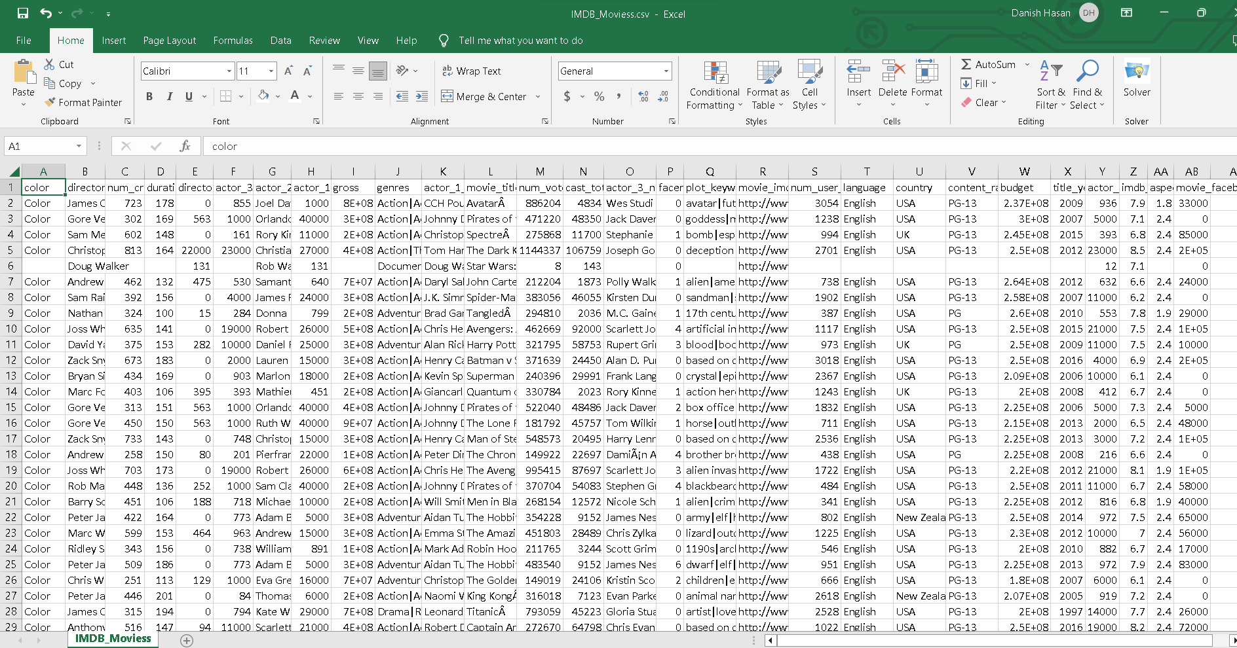
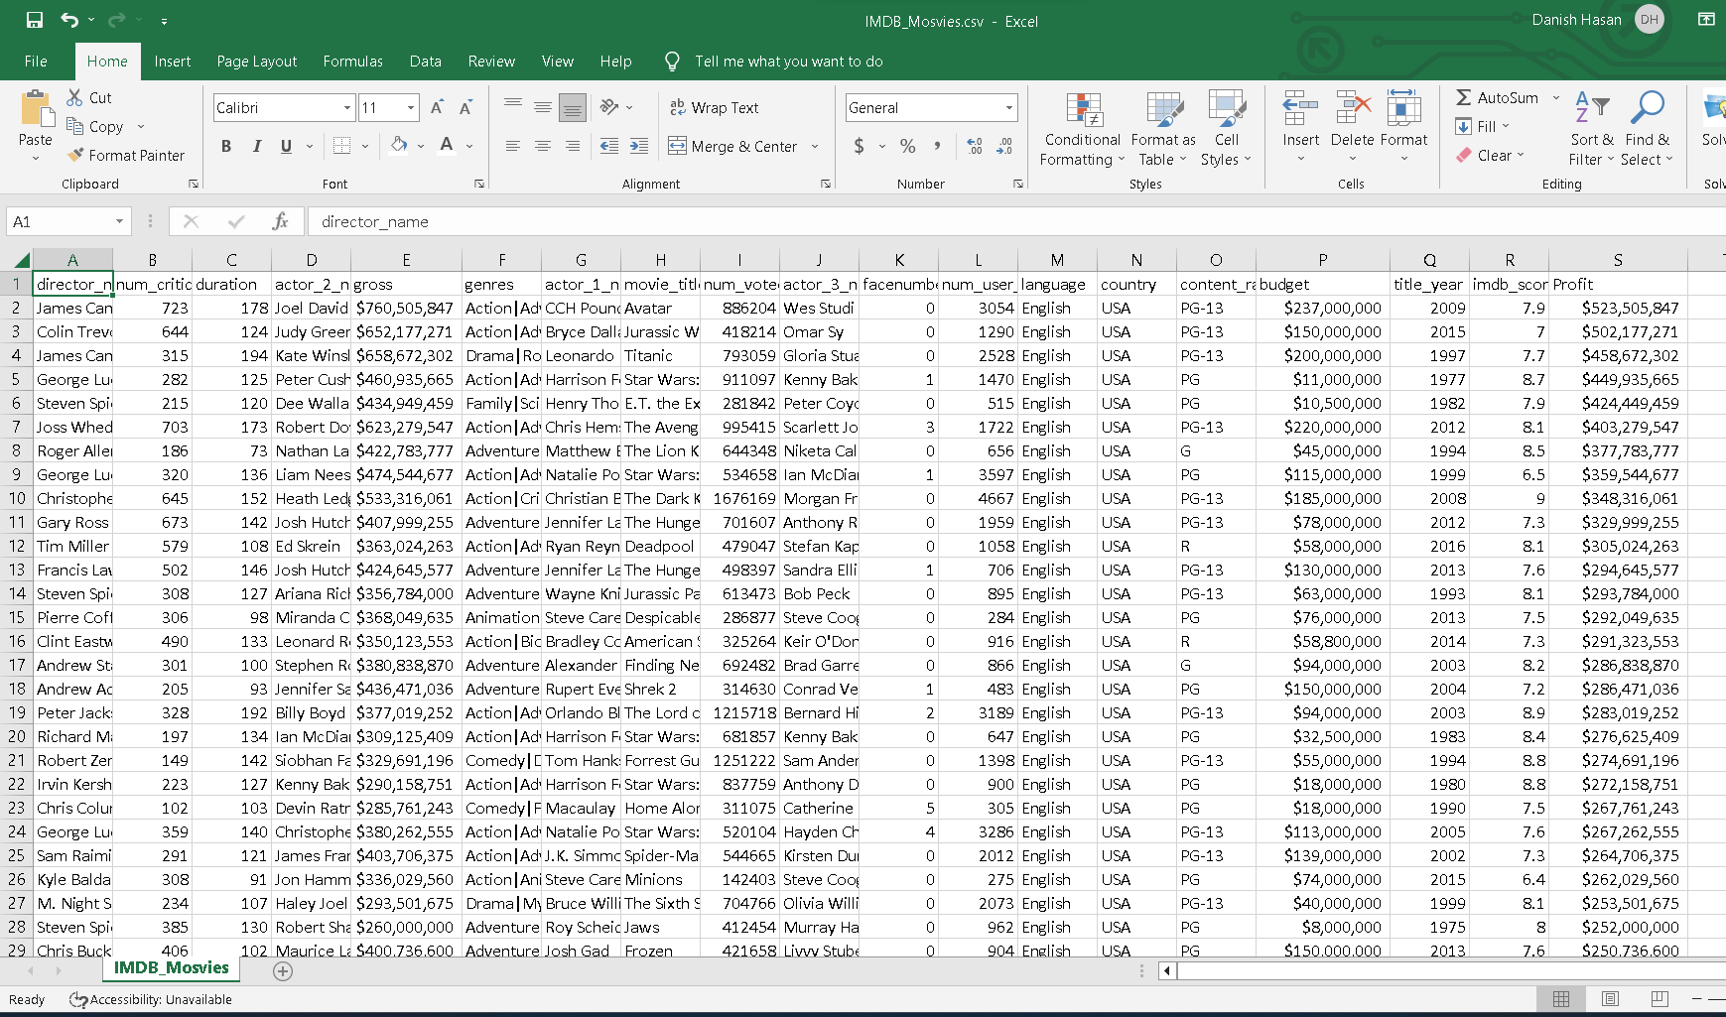
Sheet Before Cleaning:
Sheet After Cleaning:

Slide 5
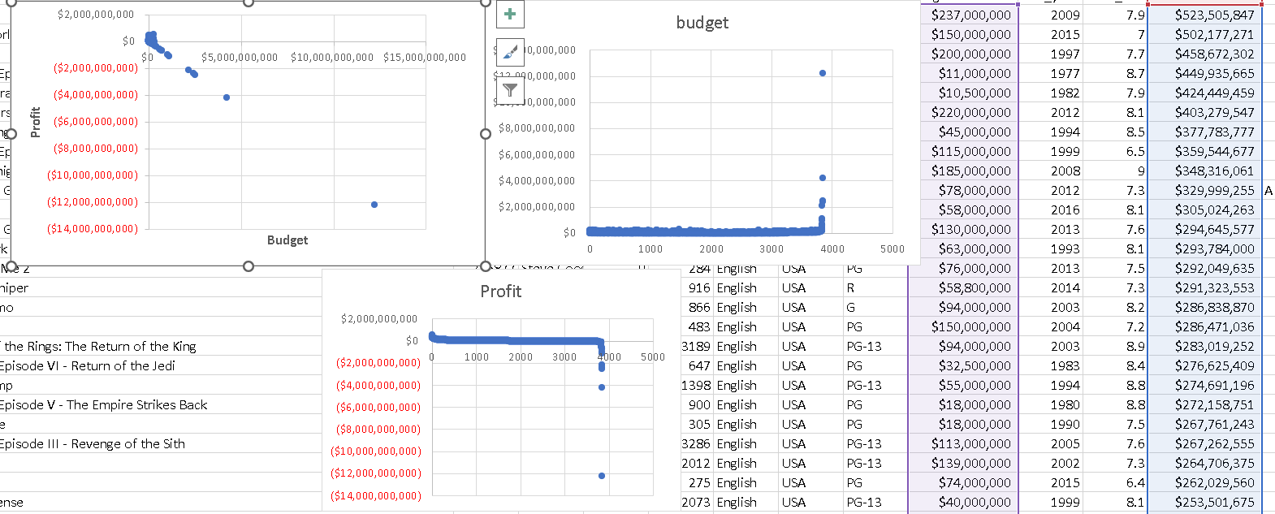
Observing Outliers for Profit vs Budget

Slide 6
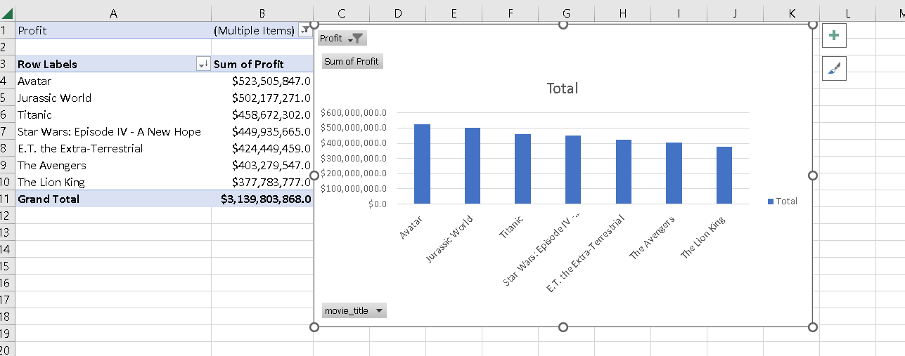
Movies with Highest Profit
Profit wise Data:
Q. Which Movie has the highest profit?
Avatar.
It clearly shows that Avatar is way ahead of others.

Slide 7
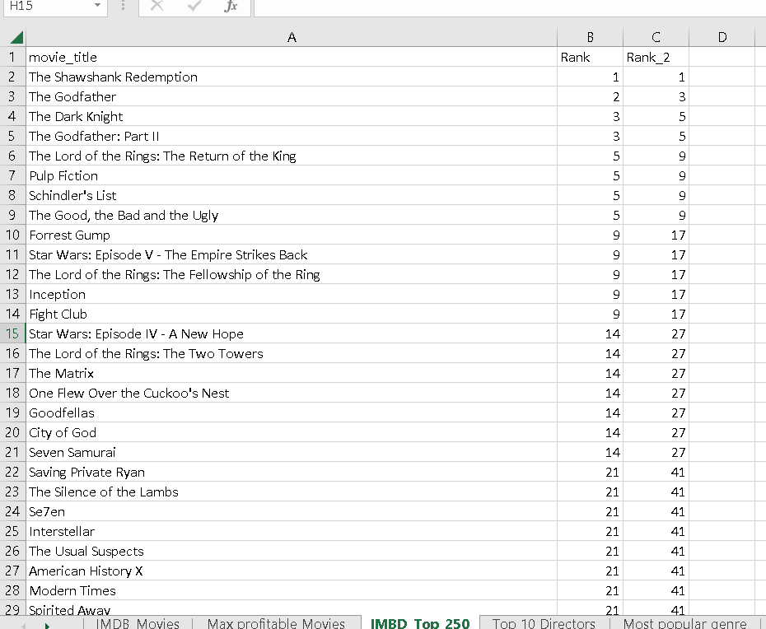
TOP 250 MOVIES ACCORDING TO IMDB RATINGS
Top 250 Movie :
Q. Find 250 Movie list by IMDB ranking having User Votes greater than 25000?
Created Ranking based on IMDB rating and created another rank for user reviews greater than 25000
Result is displayed below.

Slide 8
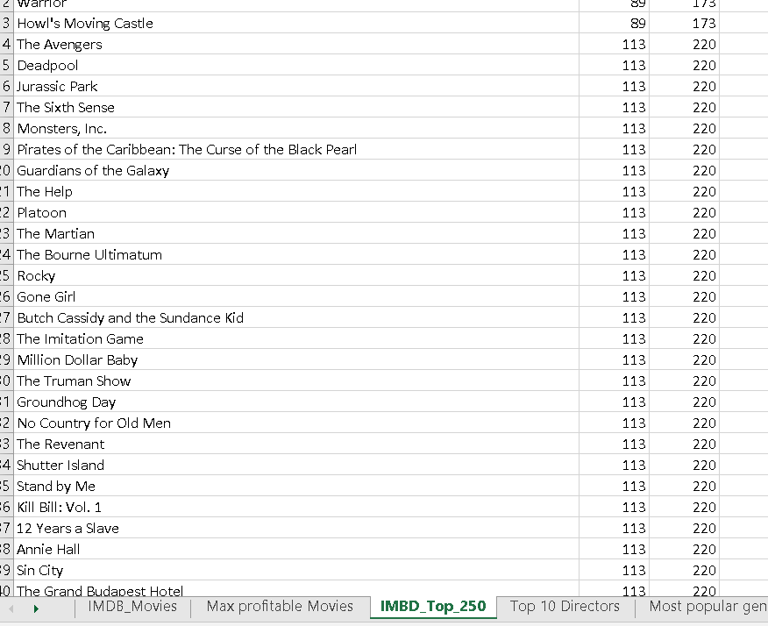
IMDB TOP 250
Top 250 Movie :
Q. Find 250 Movie list by IMDB ranking having User Votes greater than 25000?
Created Ranking based on IMDB rating and created another rank for user reviews greater than 25000
Result is displayed .

Slide 9
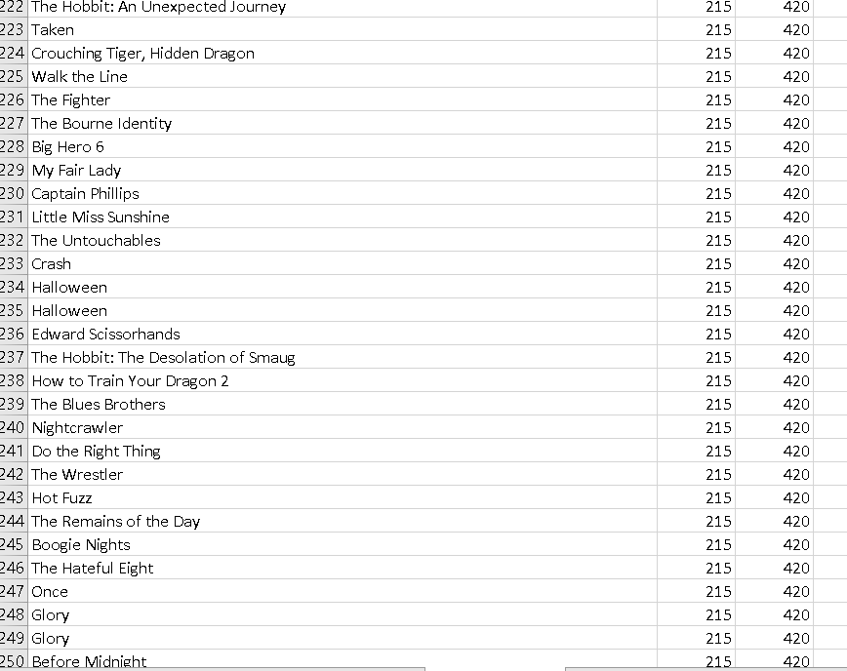
Top 250 Movies :
Q. Find 250 Movie list by IMDB ranking having User Votes greater than 25000?
Created Ranking based on IMDB rating and created another rank for user reviews greater than 25000

Slide 10
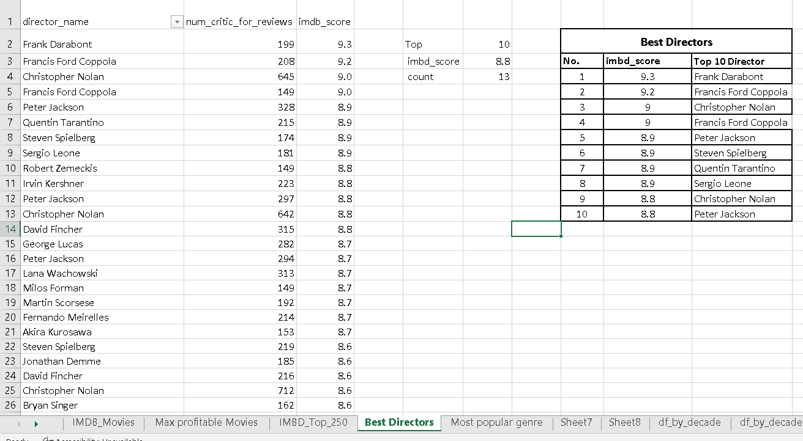
Best Directors
Best Directors:
Q. Find the best directors according to IMDB_score?
Frank Darabont tops the list.

Slide 11
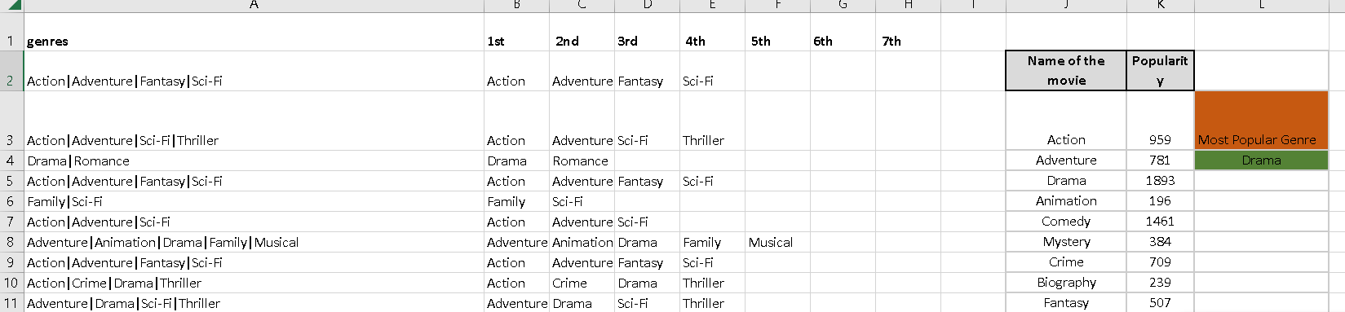
Popular Genre
Finding Popular Genres:
Q. Find the popular genres to get an idea of what kind of genre is more preferred by the people?
Maximum percentage of people work in the Operations Department.
Production & Purchase Department have the same parentage of people working.

Slide 12
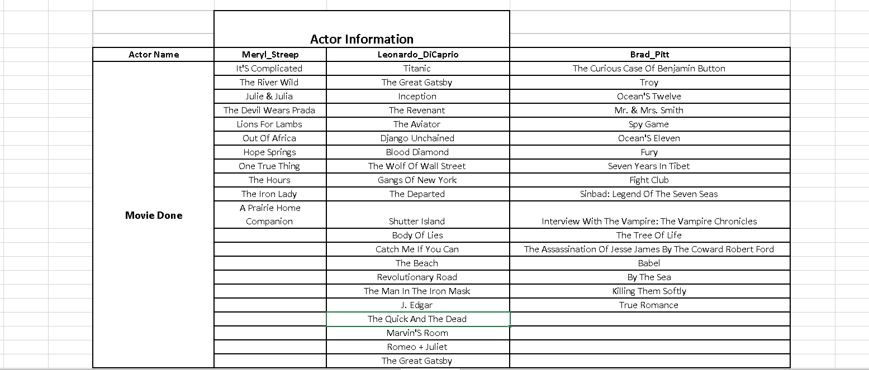
Creating new columns
Chart:
Q. Create Table.
Created three new columns namely, Meryl_Streep, Leonardo_DIcaprio, and Brad_Pitt which contain the movies in which the actors: 'Meryl Streep', 'Leonardo DiCaprio', and 'Brad Pitt' are the lead actors. Used only the actor_1_name column for extraction. Also, made sure that we used the names 'Meryl Streep', 'Leonardo DiCaprio', and 'Brad Pitt' for the said extraction.

Slide 13
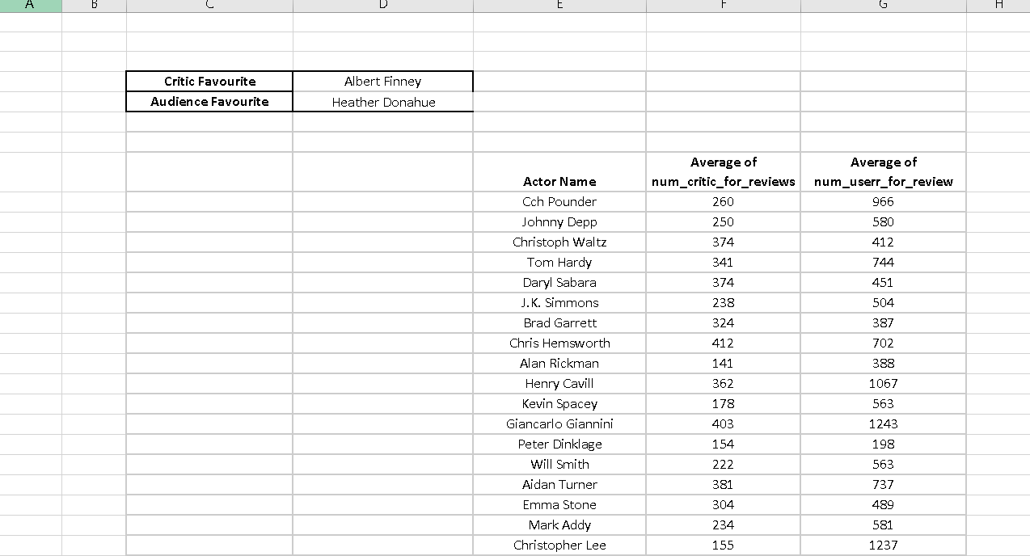
Critic Fav and Audience Fav Actors
Table:
Q. Finding favourites?
Critic favourite actor is Albert Finney.
Audience favourite actor is Heather Donahue.

Slide 14
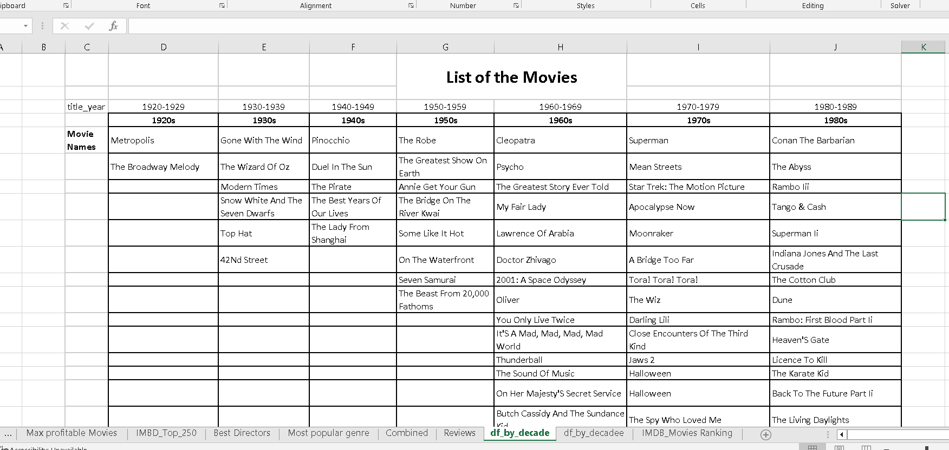
Movie segregation
All the movies have been segregated according to the year they released.

Slide 15
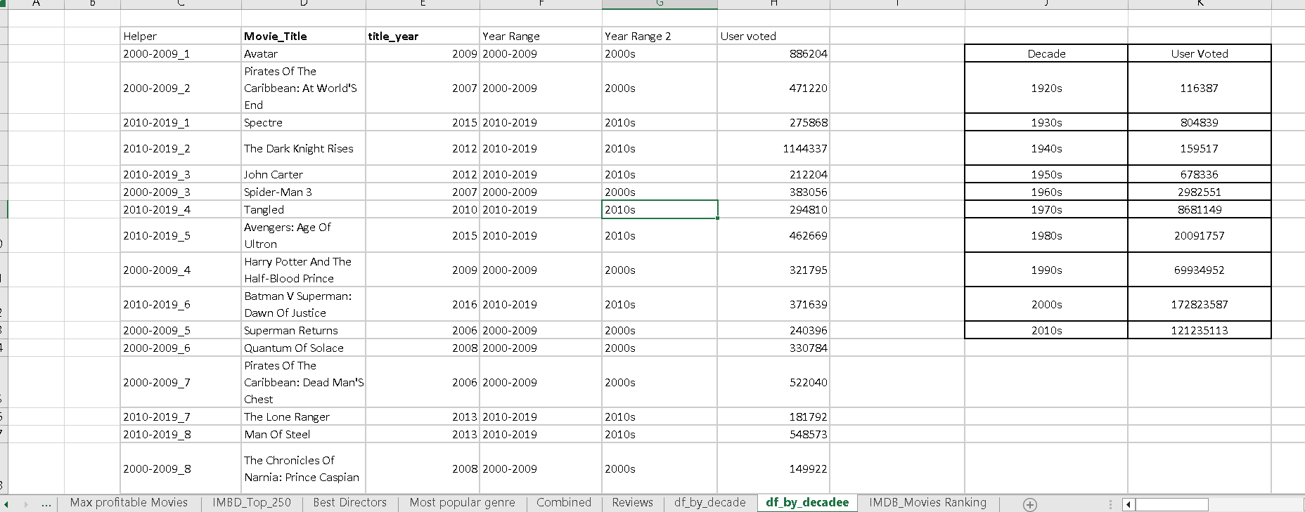
User vote according to Different decades.

Slide 16
What I have done in this project is:
IMDB movie analysis
How to segregate data.
How to find outliers.
Excel visualization.

